Slide 1
CURE: An Efficient Clustering Algorithm for Large Databases

Slide 2
Overview of the Paper
Introduction
Drawbacks of Traditional Clustering Algorithms
Contributions of CURE
CURE Algorithm
Hierarchical Clustering Algorithm
Random Sampling
Partitioning for Speedup
Labeling Data on Disk
Handling Outliers
Experimental Results

Slide 3
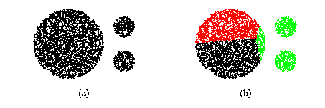
Partitional Clustering
Find k clusters optimizing some criterion:
(for example, minimize the squared-error)

Slide 4
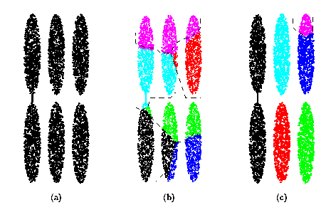
Hierarchical Clustering
Use nested partitions and tree structures
Agglomerative Hierarchical Clustering:
Initially each point is a distinct cluster
Repeated merge the closest clusters
D_avg
D_min

Slide 5
Drawbacks of Traditional Clustering Algorithms
Centroid-based approach (using d_{mean}) considers only one point as representative of a cluster - the cluster centroid.
All-points approach (based on d_{min}) makes the clustering algorithm extremely sensitive to outliers and to slight changes in the position of data points.
Both of them can’t work well for non-spherical or arbitrary shaped clusters.

Slide 6
CURE
CURE: proposed by Guha, Rastogi & Shim, 1998
A new hierarchical clustering algorithm that uses a fixed number of points as representatives (partition)
Centroid based approach: uses 1 pt to represent cluster => too little information … sensitive to data shapes
All point based approach: uses all points to cluster => too much information … sensitive to outliers
A constant number c of well scattered points in a cluster are chosen, and then shrunk toward the center of the cluster by a specified fraction alpha
The clusters with the closest pair of representative points are merged at each step
Stops when there are only k clusters left, where k can be specified

Slide 7
Contributions of CURE
CURE can identify both spherical and non-spherical clusters.
It chooses a number of well scattered points as representatives of the cluster instead of one point - centroid.
CURE uses random sampling and partitioning to speed up clustering.

Slide 8
Six Steps in CURE Algorithm
Draw Random Sample
Partially
Cluster
Partitions
Partition
Sample
Data
Label
Data
In Disk
Cluster
Partial
Clusters
Eliminate
Outliers

Slide 9
CURE Algorithm: Hierarchical Clustering Algorithm
For each cluster, ‘c’ well scattered points within the cluster are chosen , and then shrinking them toward the mean of the cluster by a fraction a.
The distance between two clusters is then the distance between the closest pair of representative points from each cluster.
The c representative points attempt to capture the physical shape and geometry of the cluster. Shrinking the scattered points toward the mean gets rid of surface abnormalities and mitigates the effects of outliers.

Slide 10
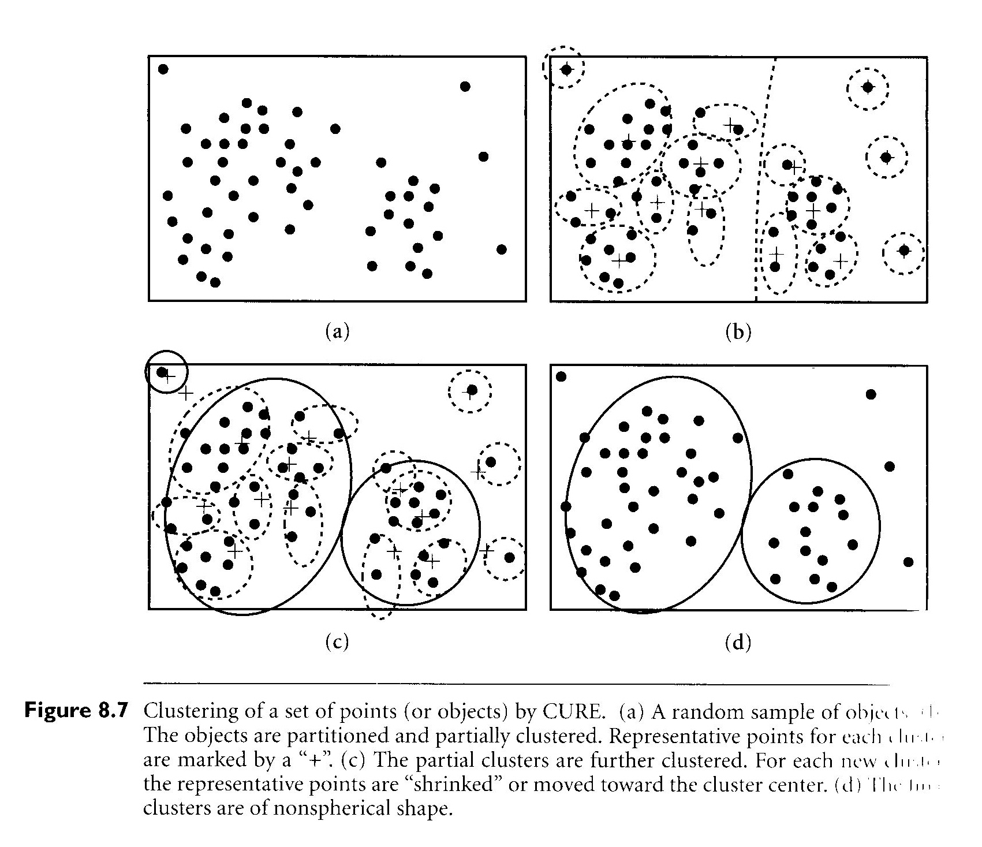
Example

Slide 11
CURE’s Advantages
More accurate:
Adjusts well to geometry of non-spherical shapes.
Scales to large datasets
Less sensitive to outliers
More efficient:
Space complexity: O(n)
Time complexity: O(n²logn) (O(n²) if dimensionality of data points is small)

Slide 12
CURE Algorithm: Random Sampling
In order to handle large data sets, random sampling is used to reduce the size of the input to CURE’s clustering algorithm.
[Vit85] provides efficient algorithms for drawing a sample randomly in one pass and using constant space.
Although random sampling does have tradeoff between accuracy and efficiency, experiments show that for most of the data sets, with moderate sized random samples, very good clusters can obtained.

Slide 13
CURE Algorithm: Partitioning for Speedup
In the first pass:
Partition the sample space into p partitions, each of size n/p.
Partially cluster each partition until the final number of clusters in each partition reduces to n/pq, q > 1.
The advantages are
Reduce execution time
Reduce the input size and ensure it fits in main-memory by storing only the representative points for each cluster as input to the clustering algorithm.

Slide 14
CURE Algorithm: Labeling Data on Disk
Each data point is assigned to the cluster containing the representative point closest to it.

Slide 15
CURE Algorithm: Handling Outliers
The number of points in a collection of outliers is typically much less than the number in a cluster.
In the first phase, proceed with the clustering until # clusters decreases to 1/3, then classify clusters with very few points (e.g., 1 or 2) as outliers.
The second phase occurs toward the end. Small groups (outliers) are easy to be identified and eliminated.

Slide 16
Feature: Random Sampling
Key idea: apply CURE to a random sample drawn from the data set rather than the entire data set.
Advantages:
Smaller size
Filtering outliers
Concerns: may miss out or incorrectly identify certain clusters!
Experimental results show that, with moderate sized random samples, we were able to obtain very good clusters.

Slide 17
Feature: Partitioning for Speedup
Partition the sample space into p partitions, each of size n/p.
Partially cluster each partition until the final number of clusters in each partition reduces to n/(pq). (q > 1)
Collect all partitions and run a second clustering pass on the n/p partial clusters
Tradeoff: sample size vs. accuracy

Slide 18
Feature: Labeling Data on Disk
Input is a randomly selected sample.
Have to assign the appropriate cluster labels to the remaining data points
Each data point is assigned to the cluster containing the representative point closest to it
Advantage: using multiple points enables CURE to correctly to distribute the data points when clusters are non-spherical or non-union

Slide 19
Feature: Outliers Handling
Random sampling filters out a majority of the outliers.
The remaining few outliers in the random sample are distributed all over the sample space and gets further isolated.
The clusters which are growing very slowly are identified and eliminated as outliers.
Use a second level pruning to eliminate merging-together outliers: outliers form very small clusters.

Slide 20
Experimental Results - Algorithms
BIRCH
CURE
The partitioning constant q = 3
Two phase outlier handling
Random sample size = 2.5% of the initial data set size
MST (minimum spanning tree)
When shrink factor = 0, CURE reduces to MST.

Slide 21
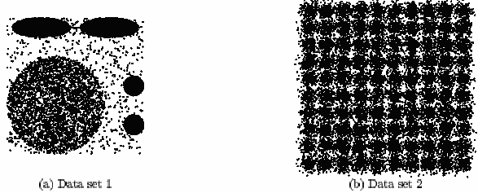
Experimental Results – Data Sets
Experiment with data sets of two dimensions
Data set 1 contains one big and two small circles.
Data set 2 consists of 100 clusters with centers arranged in a grid pattern and data points in each cluster following a normal distribution with mean at the cluster center.

Slide 22
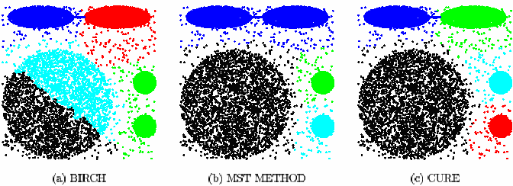
Experimental Results – Quality of Clustering
BIRCH cannot distinguish between the big and small clusters.
MST merges the two ellipsoids.
CURE successfully discovers the clusters in Data set 1.

Slide 23
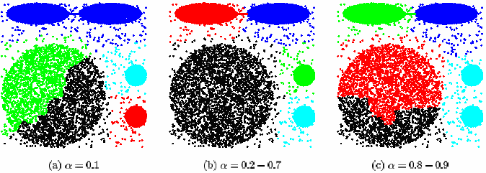
Experimental Results – Sensitivity to Parameters
Shrink Factor a:
0.2 – 0.7 is a good range of values for a.

Slide 24
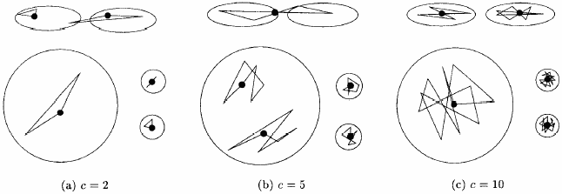
Experimental Results – Sensitivity to Parameters (Contd)
Number of Representative Points c:
For smaller values of c, the quality of clustering suffered.
However, for values of c greater than 10, CURE always found right clusters.

Slide 25
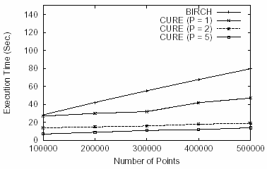
Experimental Results – Comparison of Execution time to BIRCH
Run both BIRCH and CURE on Data set 2:

Slide 26
Conclusion
CURE and BIRCH are two hierarchical clustering algorithms
CURE adjusts well to clusters having non-spherical shapes and wide variances in size.
CURE can handle large databases efficiently.

